Slide 1
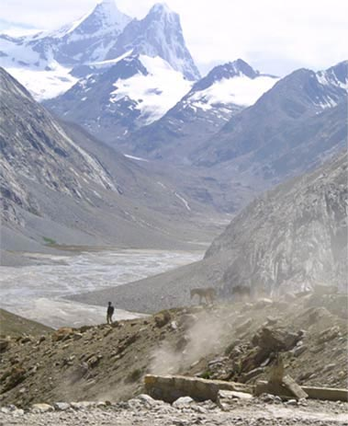
Fellowship of the Heart
Getting Started — the Four Connects, walked around the table on alternating evenings
Evening Series 2026–27 · at the Tittle home · v1.5E DRAFT
All Scripture: ESV · The Companion lesson plans carry the full scripts — these slides carry the room
1
Notes:
DECK TITLE · pre-session · DIVIDER
On screen as the room assembles on night one. All Scripture ESV; the plans carry the scripts; these slides carry the room — and these notes carry you.

Slide 2
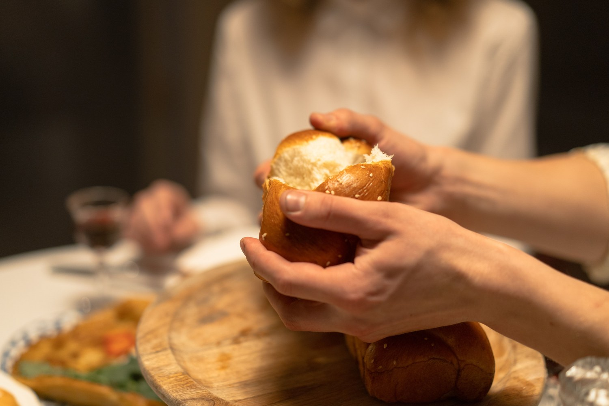
SESSION 16
Family Conversation Night
Cards and a shared meal — the night the year exhales
Quarter 3: Mission & Rhythm
198
Notes:
S16 · pre-session · DIVIDER
On screen through dinner and as the circle forms. Greet at the door — the slide holds the room.

Slide 3
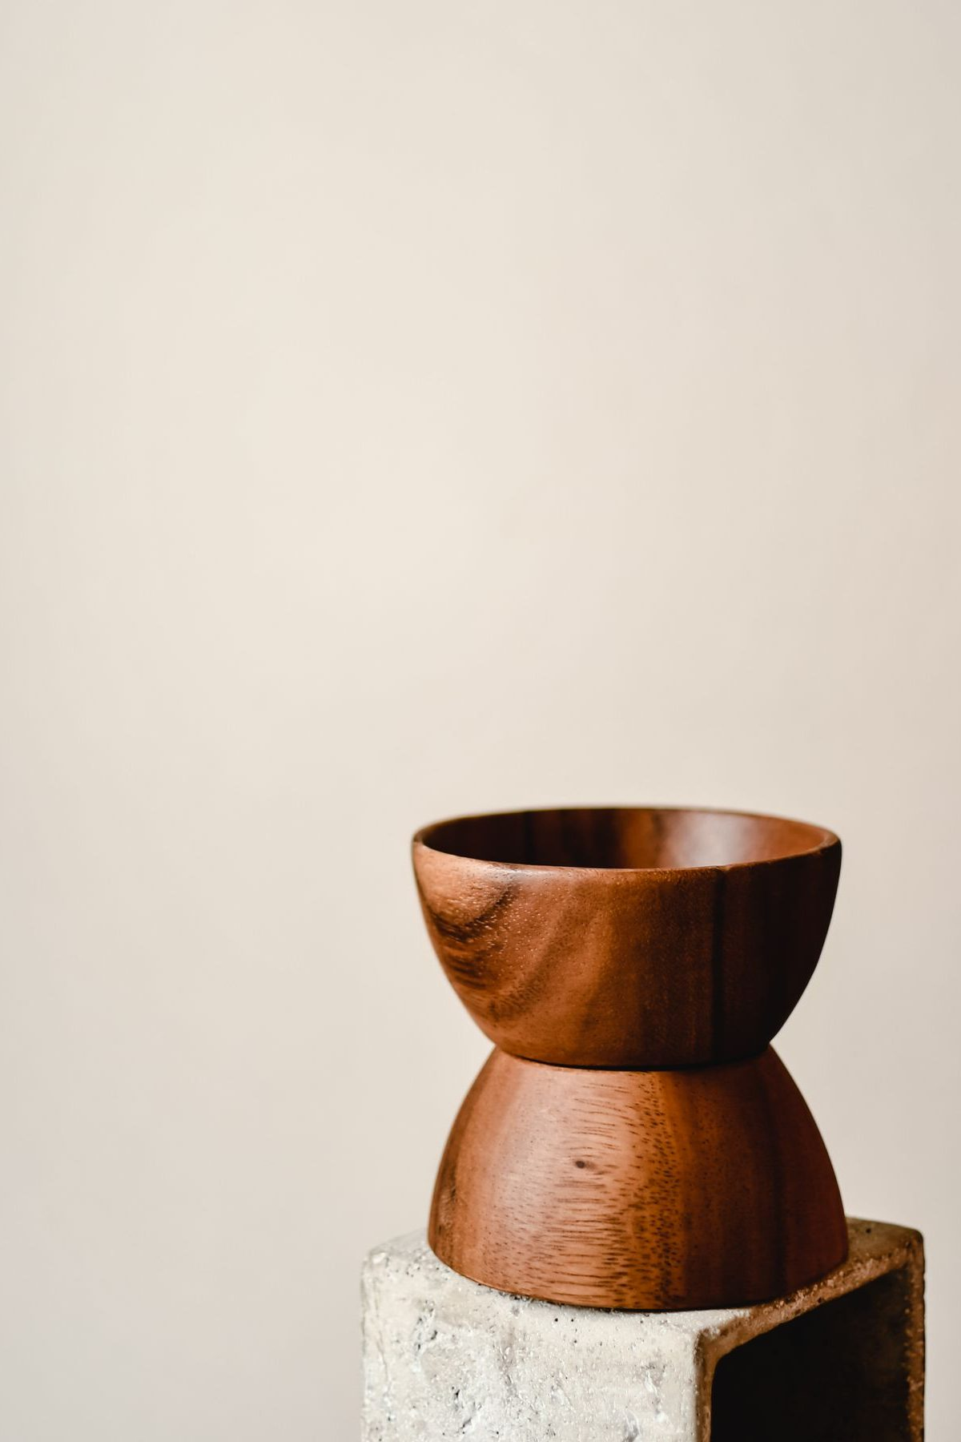
Session 16 — Tonight’s Road
1 Welcome and opening container
2 Rhythm-noticing round
3 Acts 2:46 and the table grace
4 The meal
5 Cards over dessert
6 Pulse 3 framed and sent home
7 Leader Feedback Round
8 Closing container
199
Notes:
S16 · 7:00–7:08 · LEAD: CONTAINER HOLDER · STANDING CIRCLE
BEATS: 1. Tell them the whole plan up front so nobody waits for the catch: we are going to eat together — that IS the session. A short round before food, a few good questions at dessert, one page at the end. 2. Tables today, not the circle — the one night of the year. 3. Nothing new is taught; the meal is the point.
GUARD: Do not program the meal — no devotional between courses, no teaching moment. Withholding content is today's team discipline.

Slide 4
Opening Container — the Eight Steps
1 Welcome — five minutes to open the container
2 Phones silenced and put away
3 Stand in a circle
4 One-word check-in — how you actually are, right now
5 Put out / bring in — set something down; bring a blessing in
6 Spoken commitment: “I am here. I am paying attention. I am willing to be moved.”
7 Opening prayer — “Holy Spirit, you are welcome here. Speak. We are listening.”
8 Sit. Begin.
200
Notes:
S16 · 7:00–7:08 · LEAD: CONTAINER HOLDER · STANDING CIRCLE
BEATS: 1. Blessing first. 2. Container, briefly — Safe, Present, Clear, Intentional; it holds at a dinner table too. Phones silenced and away. 3. One word for how you actually are, around the circle; receive without commentary.
GUARD: Keep the open genuinely short — the room is smelling the food. A long preamble teaches the room the team cannot help itself.

Slide 5
Rhythm-Noticing Round
• One round before we eat — one sentence each
• “Where has your card held, or where has it slipped?”
• Both answers are welcome — a slip you noticed is the practice working, because noticing is the skill
• No fixing, no advice — a parent starts; pass-anytime holds
– “The card is a long walk; sixteen days in, everyone in this circle is still on it.”
201
Notes:
S16 · 7:25–7:29 · LEAD: CONTENT PRESENTER · STANDING CIRCLE
BEATS: 1. One sentence each: where the Rhythm Card held, or where it slipped — both welcome; a noticed slip is the practice working. 2. No fixing, no advice, from anyone; if troubleshooting starts: good noticing — hold the fixing. 3. Close it: sixteen days in, everyone in this circle is still on the long walk.
CUES: The arranged parent opens (Run Card) — never a cold call on a teen; pass anytime.
GUARD: Watch quietly — whoever reports a slip with shame gets a warm follow-up this week; note it for the debrief, not the circle.

Slide 6
Acts 2:46 and the Table Grace
• Luke is describing the very first church — the most spiritually alive room in the history of the world
• The first church ran on three rails: the teaching, the table, and the prayers
• Our Wednesdays have lived on the teaching and the prayers — tonight is the table
• “Breaking bread with glad and generous hearts is not the break between the formation — it is the formation.”
• The grace — then: eat
ACTS 2:46 (ESV)
“And day by day, attending the temple together and breaking bread in their homes, they received their food with glad and generous hearts.”
202
Notes:
S16 · 7:29–7:31 · LEAD: CONTENT PRESENTER · STANDING CIRCLE
BEATS: 1. Read Acts 2:46 — the first church, glad and generous hearts. 2. Thirty seconds of frame: the first church ran on three rails — the teaching, the table, the prayers; today is the table, and it IS the formation, not the break from it. 3. Pray the grace. 4. Send them to eat.

Slide 7
The Meal
• Real food, no agenda — no devotional between courses, no teaching moment
• “We are going to eat together. That's it. That's the session.”
• Phones silenced and put away — the people at your table tonight are the evening
• Dessert is held back — dessert arriving is the signal the cards are coming
203
Notes:
S16 · 7:31–7:59 · LEAD: CONTENT PRESENTER · TABLES
BEATS: 1. No agenda — Companions sit and eat as members of their tables; the cohort needs to see its Companions laugh at dinner. 2. Watch faces gently, especially the Week 15 watch-list: a family sitting close and quiet, a parent with full eyes, a teen who won't look up — nobody names it today; offline contact within 48 hours. 3. Keep the food moving; note who is missing for the Sought Stray line.
GUARD: The allergy list is law — posted, current, every dish labeled with its allergens; the food-safety lead owns the serving table. Never ask, at a table or from the front, whether the Four Questions happened — invisible by default.

Slide 8
Cards over Dessert
• A small stack on your table — someone reads the first card aloud; a parent answers first, every table, every card
• Then anyone who wants to answers, in any order — nobody has to. When the card feels done, read the next one
1 One footprint — “Looking back at this past month — one place you can see God's hand more clearly now than you did at the time.”
2 Where you came alive — “What activity, conversation, or work this season has made you most alive? Why?”
3 The ten-year question — “What's one thing you hope is still true between us in ten years?”
• No report-out — what is said at your table stays at your table. Ten minutes of laughing at your dad's answer is not a failure of the exercise — that IS the exercise
204
Notes:
S16 · 7:59–8:17 · LEAD: CONTENT PRESENTER · TABLES
BEATS: 1. Dessert lands and the card stack comes out — frame it from your seat; standing up breaks the spell. 2. How it works: read the card aloud; a parent answers first, every table, every card; anyone who wants answers; nobody has to; next card when it feels done. 3. Two rules said aloud: no report-out — what is said at your table stays there; and there is no wrong way for this to go.
GUARD: Laughter is a fully valid outcome — ten minutes laughing at dad's answer IS the exercise. Two cards done well beats three done fast. A card that finds a tender place: warmth, no working it at the table; a Companion follows up offline.

Slide 9
Pulse 3 Framed and Sent Home
• The Quarterly Pulse, third one this year — one page, three questions, about five minutes, at home
1 Presence — how present have I actually been in these sessions this quarter? Not attendance, presence (1–10, and one sentence why)
2 Surprise — one thing that has surprised me this quarter — about myself, about God, or about someone in this room
3 Steering — one specific way I want to engage differently in the final quarter
• “This room steers by these pages” — the final quarter, the consolidation weeks and the two commissionings, is shaped by what you write
• Back next Wednesday, in the bin at the door — signed or unsigned, your choice; nobody watches the bin
205
Notes:
S16 · 8:17–8:20 · LEAD: CONTENT PRESENTER · WHOLE ROOM (seated)
BEATS: 1. One unhurried minute, no apology: this is the Quarterly Pulse, third of the year — one page, three questions, about five minutes at home. 2. Say the deal plainly: this room steers by these pages; the final quarter is built from what you write. 3. Back in the bin at when we gather's door — nobody watches the bin; signed or unsigned, your choice.
GUARD: 'Sorry to end a fun night with paperwork' undoes the instrument — frame it as steering, never homework.

Slide 10
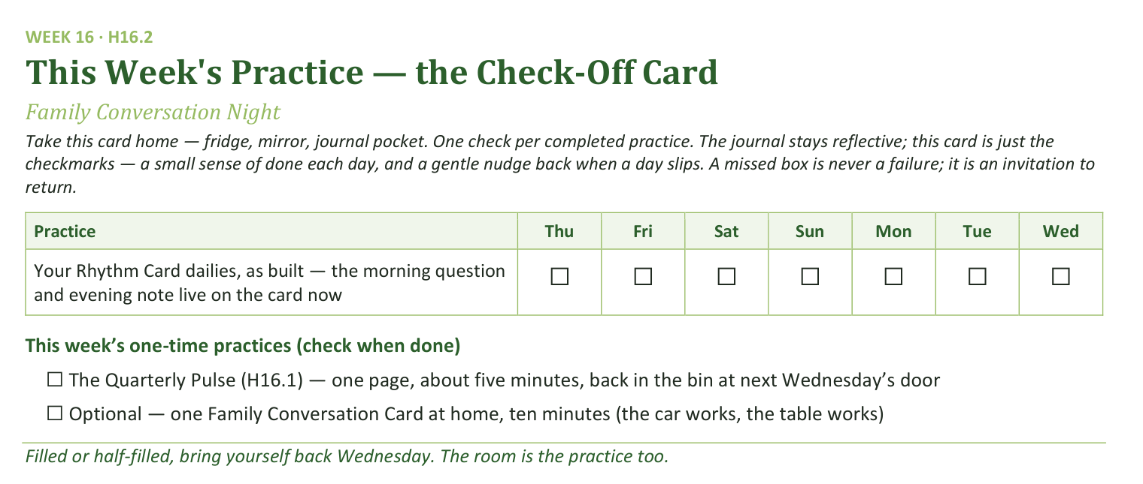
Your Take-Home Card — This Session’s Practice
Handed out now — fridge, mirror, journal pocket.
206
Notes:
S16 · 8:17–8:20 · LEAD: CONTENT PRESENTER · WHOLE ROOM
BEATS: 1. One daily row: your Rhythm Card dailies as built — the morning question and evening note live on the card now. 2. One-time boxes: the Pulse, five minutes, back in the bin when we gather; optional — one Family Conversation Card at home, ten minutes. 3. A missed box is never failure — an invitation to return.

Slide 11
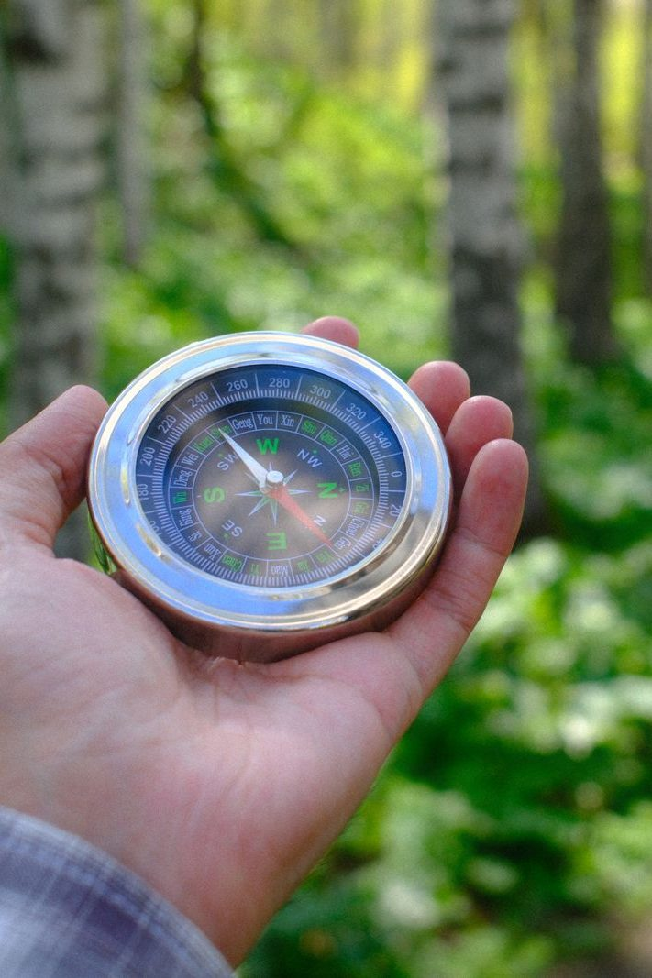
The Leader Feedback Round
• Two rounds, same as every session — the container holder first, then the content presenter: three things each
– “What I think went well tonight: ______”
– “What I’d do differently next time: ______”
– “If I were to teach tonight’s process to someone, I would tell them: ______”
• Then the room — the same two questions about tonight
• The leaders receive without defending — “thank you” is the whole response
207
Notes:
S16 · 8:24–8:28 · LEAD: BOTH LEADERS · WHOLE ROOM
BEATS: 1. Same round, even on a dinner night — especially today; the round on an easy evening is what keeps it ordinary. 2. The leader's three, then the room's two questions — two or three voices each. 3. Receive without defending — 'thank you' is the whole response.
CUES: Expect food commentary; take it seriously — next year's family night is built from today's answers.

Slide 12
Closing the Container + Aaronic Blessing
• We close the way we opened — the container, six steps:
1 Stand again — same circle, same posture as the open
2 One-word landing — compare it to your opening word
3 The one thing you are taking from tonight
4 The one practice — committed aloud, or modified to one you will actually keep
5 Blessings — specific, witnessed, short
6 Closing prayer — and the Aaronic blessing, spoken over each other, face to face
THE AARONIC BLESSING — NUMBERS 6:24–26
“The Lord bless you and keep you;
the Lord make his face to shine upon you, and be gracious to you;
the Lord lift up his countenance upon you, and give you peace.”
208
Notes:
S16 · 8:28–8:30 · LEAD: CONTAINER HOLDER · STANDING CIRCLE
BEATS: 1. Same circle as the start; one word for what is happening in you as we close. 2. Two thank-yous: every hand that cooked and served, and the cleanup crew by name; everyone clears their own place. 3. The week: five minutes with the Pulse, bin at the door when we gather; keep walking your card, slips and all. 4. Aaronic blessing. Go home glad.

